Slide 1



UNIT 5: Where I live
Amy Short

Slide 2
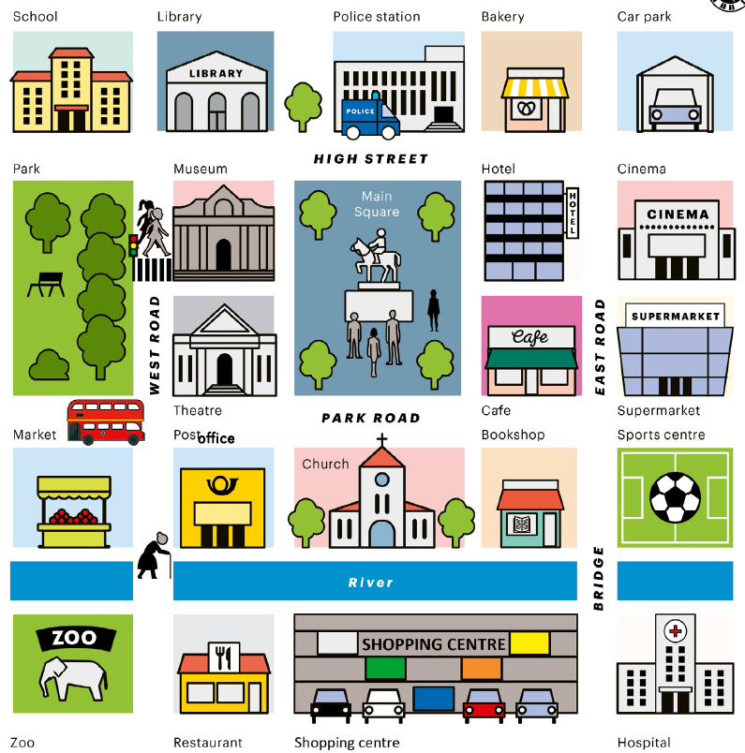
Look at the map of Ollie’s town.
Your teacher says:
”I’m in Ollie’s hometown. You can’t see me because I’m in a building. Guess which one!”
Ask Yes/No questions and find out.
It’s a police station.

Slide 3
What do people do at a police station?
Why do they go there?
Who can you see there?
Do you know a police officer?
What is he/she like?

Slide 4
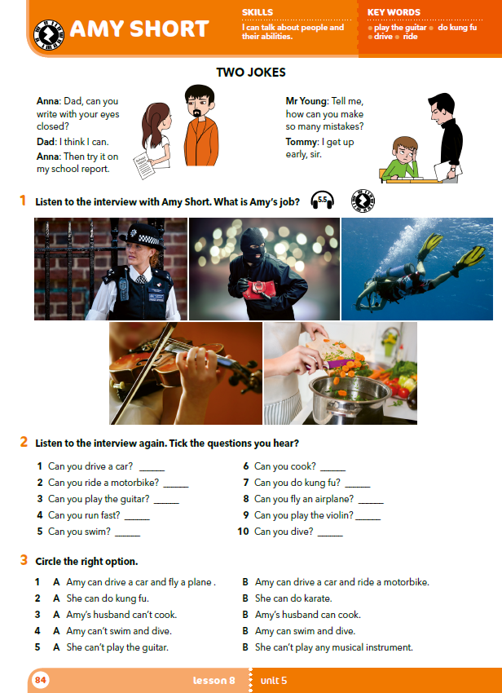
What can you see in the picture?
Who can you see?
What are they doing?

Slide 5
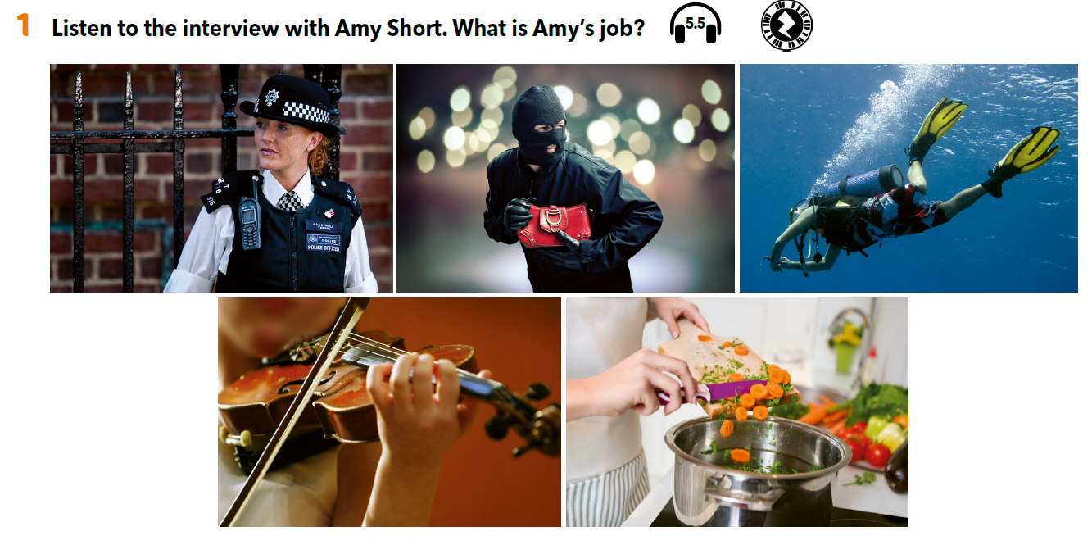

https://www.e-sfera.hr/dodatni-digitalni-sadrzaji/a9f7aa15-ad84-4393-98d2-8b4a055c9d53/assets/audio/39_amy_short.mp3
Listen to the intervju and answer the question: What is Amy’s job?
Amy is a police officer.

Slide 6
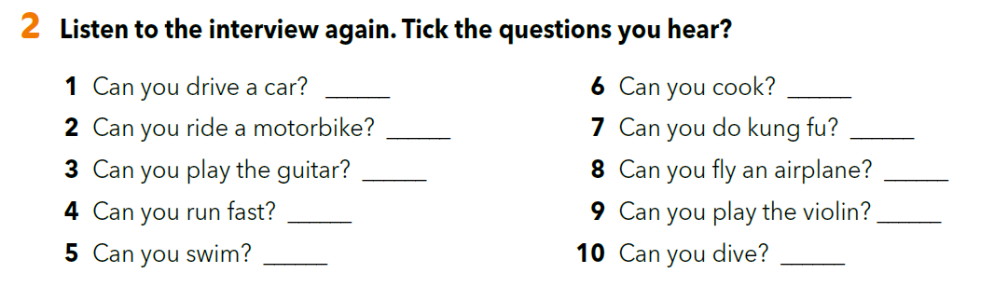
✓
✓
✓
✓
https://www.e-sfera.hr/dodatni-digitalni-sadrzaji/a9f7aa15-ad84-4393-98d2-8b4a055c9d53/assets/audio/39_amy_short.mp3
Listen to the interview again and check your answers.

Slide 7
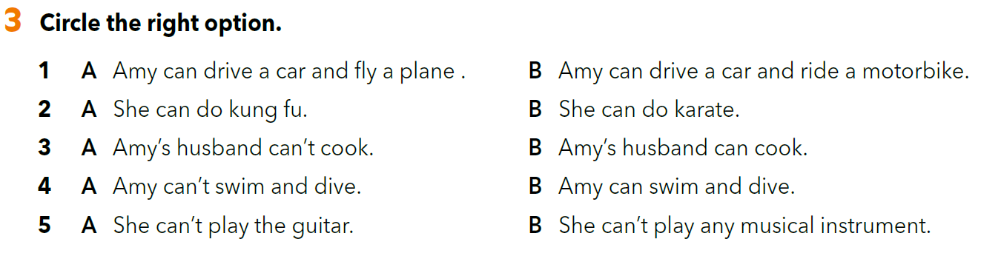
https://www.e-sfera.hr/dodatni-digitalni-sadrzaji/a9f7aa15-ad84-4393-98d2-8b4a055c9d53/assets/audio/39_amy_short.mp3
Listen to the interview again and check your answers.

Slide 8
Choose three questions from task 2 that you don’t like and write three new questions in your notebook.
Circle the questions that you didn’t change in your book.
Don’t show your question to your classmates.

Slide 9
Use the questions from task 2 and your notebook to interview your partner.
Write Y (=yes) or N (=no) next to each question.
Your teacher will assign you a new partner.
Tell him/her what you’ve learned about your previous partner.

Slide 10
Write a short text about a student that you interviewed.
Write five sentences about the things that your partner can do and five sentences about the things that your partner cannot do.
How much do you remember about Amy?
https://www.bookwidgets.com/play/t:gp2NifZP1GjmYipLb5WZl0EYINj4aGjd6fHVUFohPf1URU5TRks=

Slide 11
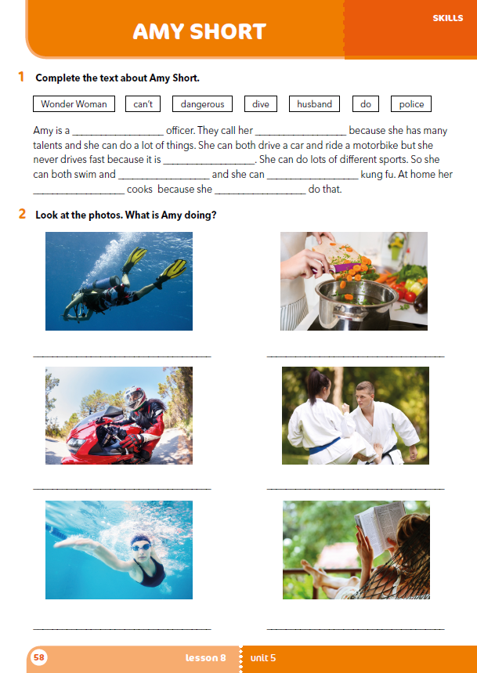
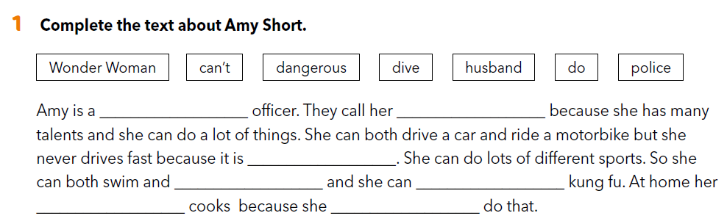
Workbook p. 58
police
Wonder Woman
dangerous
dive
do
husband
can’t

Slide 12
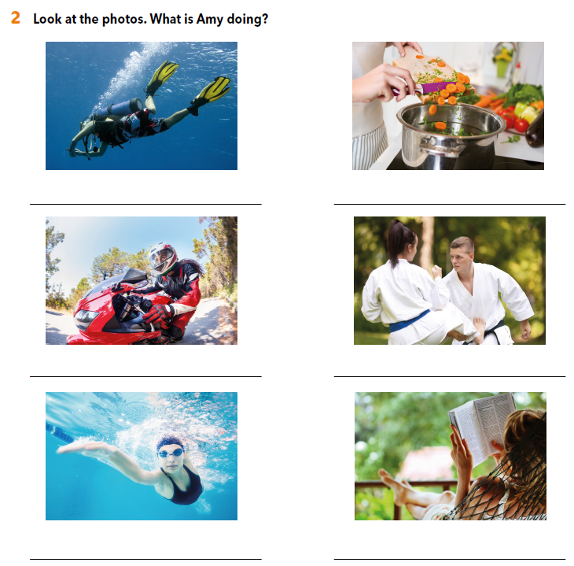
Amy is diving.
Amy is cooking.
Amy is riding a motorbike.
Amy is doing karate.
Amy is swimming.
Amy is reading a book.

Slide 13

LEARN MORE.
https://www.e-sfera.hr/dodatni-digitalni-sadrzaji/a9f7aa15-ad84-4393-98d2-8b4a055c9d53/
Many skills for one job

